Slide 1

Testing code

Slide 2
Module Objectives
What is Software Testing?
Why is Software Testing Important?
What are the benefits of Software Testing?

Slide 3
What is Software Testing?
Is to check whether the Application Under Test (AUT) meets the expected requirements
Making sure all the requirements are satisfied
Program code and logic is error free
Logical errors
Arithmetic calculations
Interface errors …
Application errors
Different modules work well together. Interface between them is correct
System as a whole works
Eliminate Runtime errors. Works on the target OS/client system
if (salary >= 12570) {
taxRate = 0;
}

Slide 4

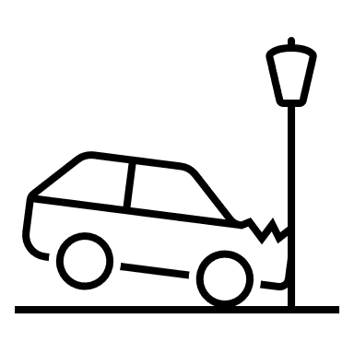
Why software testing is so important?
Testing helps to solve problems early because
Bugs are expensive to fix in production
They are costly to fix £££
Lives could be affected
Airline, Transport, Hospital…
Reputation could be affected.
It takes a lifetime to stablish reputation, A single day to lose it!
See disasters caused by bad software testing
https://dzone.com/articles/the-biggest-software-failures-in-recent-years

Slide 5
There are many types of tests.
They can be categorised as:
Unit Testing
Integration Testing
System Testing
Acceptance Testing
What are the different types of test?

Slide 6

Unit testing
It is a form of Functional testing
Tests individual units (Classes, Methods…) in isolation
To make sure your code is defect free
Is typically the duty of the developer who wrote the code
It is the first level of testing in dev
When to write Unit tests ⌚
Write tests while coding (or before coding in TDD)
Before Integration testing: Ensures that each module works
When a bug is fixed, new unit tests to prevent regression (previously working feature don’t break)

Slide 7


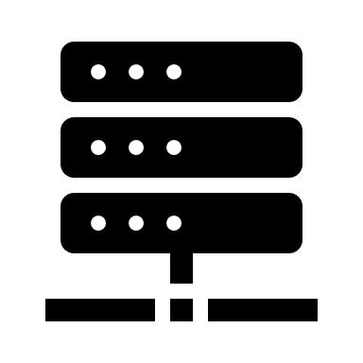
Common causes of Regression tests failure
Bug Fixes Affecting Other Features Example: Fixing a security issue accidentally breaks user authentication
New Features Breaking Existing Functionality Example: Adding a new payment method causes old transactions to fail.
Code Refactoring Gone Wrong Example: Renaming a function but missing some places where it was used.
Dependency Updates Example: Updating a third-party library changes its behavior and breaks integration.
Merging Code Changes Example: Two developers working on different parts of the code introduce conflicting logic.
⛓️‍💥
❌👎🏻

Slide 8



How to Detect and Prevent code failure
Run automated tests frequently - to ensure old functionality still works
Write new tests with every change in code
Ensure every module behaves as expected after any change 👍🏻
Automated test execution in pipelines (Example: using Ci/CD Jenkins)
Peers reviewing changes to catch issues early
commit
Build
Test
Deploy
GitHub
Writing code is only half the job — testing completes it!

Slide 9
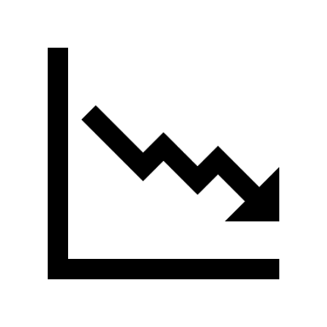


What is System testing?
Is testing the whole system. For example:
Recoverability Can we continue after a disaster!
Performance Can many users use the system and get a good performance? Requests/second
Scalability Multiple users using the system at the time. / Capacity Can servers scale horizontally ?
Geographies Works well across different physical distances between its components
Reliability Ensures that the system can operate over long span of time (SLA)
LB

Slide 10






What is System testing?…
Security is a system requirement
Authentication and Authorization.
Data validation
Transport security
Data protection
Usability
How usable is our system. How do we measure this? https://www.usability.gov/how-to-and-tools/methods/system-usability-scale.html
Compatibility
Can run in different browsers, database, hardware, OS, mobile devices, and networks

Slide 11
What are the different types of test?
The different types of tests can be further categorised as
Black Box Testing
No insight into code is necessary
Often involves manual testing of the requirements
Software is seen as a black box with input and output interfaces
White Box Testing
Knowledge is required to create a code coverage
Tests the code and its logic
Black-Box
Input
Output
Observer
var writeResponse = function(res, str) {
res.writeHead(200, { 'Content-Type': 'application/json' });
res.end(str);
}
var writeJsonResponse = function(res, str) {
writeResponse(res, JSON.stringify(str));
}
apis = "/customerByID/\n/customers\n/orders\n/ordersByCustomerid/\n/orders\n/orderbyCustomerid/"
var writeHelp = function(res) {
res.writeHead(404, { 'Content-Type': 'text/plain' });
res.end(apis);
}
var notFound = function(res) {
res.writeHead(404, { 'Content-Type': 'text/plain' });
res.end("The data you have requested could not be found");
}
const server = require('http').createServer();

Slide 12
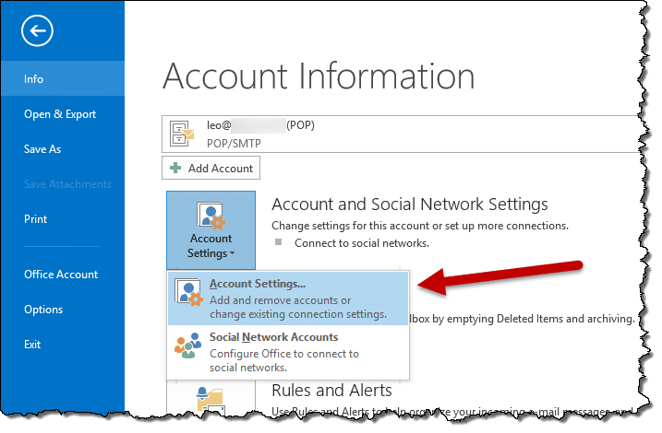
User Acceptance Testing (UAT) or End-User Testing
Is the final phase of software testing
Real users or business stakeholders test the system
to ensure it meets their requirements before it goes live.
When is UAT Done?
After Integration & System Testing Once the software is stable.
Before Deployment To verify that the product is ready for production
When Business Users Need to Validate Requirements Ensuring it meets actual use-case

Slide 13


Manual and Automated tests
Tests can be performed manually by a tester or
It can be automated to run with little manual intervention
Let's explore the pros and cons of
Manual testing
Automated testing
In real-life of course you would use a mix of these when required but favour automation but why? Let's see…

Slide 14
Manual testing method
It can’t be designed and performed by anyone
Requires deep analysis of the requirements and specialised knowledge of testing
It uses the intuition and the expertise of the tester
We often require both types of tests, manual and automated.
It is sometimes easier to manually test
Consider setting up a complex and costly test bed for automation.
Even small UI change requires a re-write of Unit tests whereas a manual tester would be less affected.
May not catch 100% of the bugs, but what can!
Exploratory tests by a manual tester may find bugs that are not directly related to the requirements.

Slide 15
Automated testing…
Some types of tests are not easy to perform using the manual testing methods
And there are tests which are impossible to carry out using a human operator, like:
Performance tests
Threading and parallel execution
Load tests
Penetration test,
brute attacks…
Note: Any automation test needs to be simple and bug free!

Slide 16
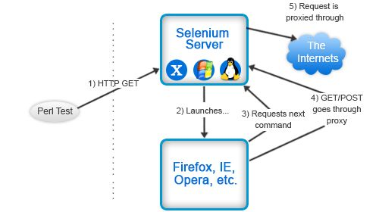
Automation tools - Selenium
In this course you will use Selenium to automate testing tasks
Is Open source.
Widely used to test applications for regression testing
Has record and playback facility.
Recordings can be exported and reused.
in other languages like Java, C#, Python…
Can be used with xUnit
Can execute multiple tests at a time
Notes:
Image from https://www.pinterest.co.uk/pin/220746819208887040/

Slide 17
Software testing principles - Exhaustive testing
Exhaustive testing is not possible because of many constraints
Time
Cost of exhaustive testing
Knowledge of code complexity
Context sensitivity
Effort must be based on risk factor The way you test an e-commerce site is different then a POS or e-Dynamic site.
An example of why exhaustive tests is so hard
Every time I move a file I must test:
Security rights Destination folder exits and has enough space. Destination has a read-only file with the same name Then start writing code to test the logic of the move

Slide 18





Testing principles - Defect clustering
Bugs keep each other company in small number of modules
80% of bugs appear in 20% of modules. Concentrate on these!
Use your experience to concentrate effort on the right modules
UI | Cart Service
Purchase & dispatch Service modules

Slide 19

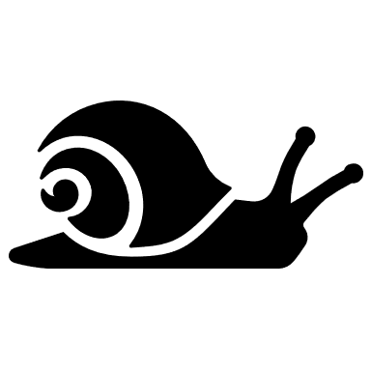
Testing principles - Pesticide Paradox
If you use the same test, using the same test data, developers will make sure the code pass the same tests!
Solution: Use a different set of data with new tests to challenge your code and find new bugs!
New code

Slide 20
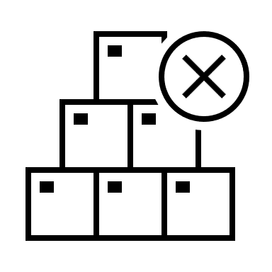

Testing principles - Absence of error fallacy
Code could be correct, but it may not satisfy the user requirements!
Could be testing the wrong things, wrong modules, wrong requirements!
Could be written by a biased developer
App not working!

Slide 21

Testing principles – Test early & context sensitivity
Test as early as possible
Should never be an after thought. It is an important part of software development
Start designing test right at the start of an SDLC and then throughout.
Define requirement and UATs, Unit test, integration…UAT tests before release

Slide 22
SDLC – Waterfall tests
Feasibility Study
A typical sequence in ADLC is
Gather requirements and analyse
Design your code, OS, Modelling techniques like UML, choose a language, database etc.
Build modules of code
Test everything
Deploy
Maintain (new requirements, enhancements, and bugs)
The main problem with this mode is changes in requirements
Changing software in late stages is very expensive
Test early and pay less!
Requirements Analysis
Design
Code Development
Testing
Deployment / Implementation
Maintenance

Slide 23
How can V-Model help with testing
V-Model of development develops a test at each stage
Requirements gathering and analysis System testing
High level design of modules Integration tests
Low level code design Unit tests
Ensures no requirement is missed or ignored
Can be used in iterative phases with each phase following a V-model testing strategy.
Business Requirements
User Acceptance Testing
Acceptance Criteria
System Requirements
System Testing
Acceptance Criteria
High-Level
System Design
Integration Testing
Interface Specification
Unit / Component
Design
Unit Testing
Program
Specification
Development (Programming)

Slide 24
Exercise
In this lab you will:
Examine an application written in C# or Java and create corresponding unit test specifications.

